Slide 1

Responding to the challenges of internationalisation in an environment of change
Hazel Horobin, Miyoung Oh, Chris Cutforth
Faculty of Health and Wellbeing
Department of Sport

Slide 2
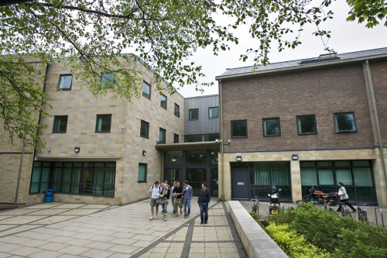
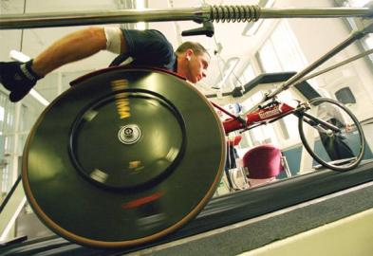
Outline:
University context
Faculty context and approach
Case study
Summary
Questions & discussion
Notes:
To offer an insight into the context of the work done around internationalisation in the Sport Department - through both an overview and in the detail of the pedagogic environment

Slide 3

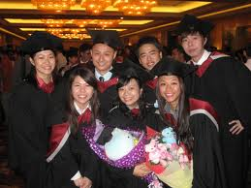
Fast Facts:
3rd Largest in the UK - over 37,000 students, 17% pay international student fees
Recruitment areas dominated by Malaysia, China and India
Strong employability focus
Middle ranking University
Strong sports brand (Academy)
3 research centres, 2008 RAE 4th in UK for sports related research
Notes:
Sport dept mainly Asia, North America, EU - mostly postgraduate
International market and business development opportunities
over half of all courses offer integrated practice or work placement opportunities
4,170 staff (including 2,064 academic staff), and a turnover of £242.8m - 17% is 2,700 approx
1,030 (38%) of overseas fee students were from Malaysia, 896 (33%) China and 233 (9%) India
and 50% classed as mature
9th highest recruiter of sports science students
Physical Education Sport Coaching
Sport Development Sport Management Sport Science Sport Engineering Sport Culture
position 4th in RAE

Slide 4
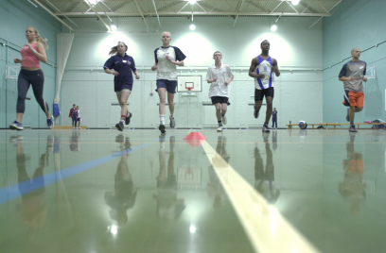
Conditions for change
Contexts for the University and for the Faculty
The main recruitment area for the Faculty is India - impact of the PSWV
Each department is different and the largest recruiters are bioscience and health these dominate the Faculty activity
University strategy

Slide 5
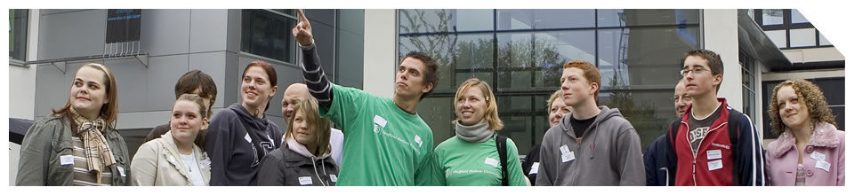
The University International Strategy
at least 15% of SHU's FT students from outside the UK with at least 12% of SHU's income generated by international activity by 2014
a strong SHU presence and brand position in a number of strategic international locations
a differentiated, educationally strong and demand-responsive offer for the international market
international success driven through strong mutually beneficial partnerships and collaborations
and
globally aware and engaged SHU students and staff
Notes:
educationally successful and financially profitable programmes delivered overseas

Slide 6
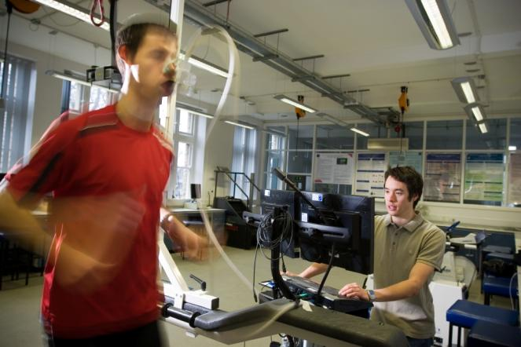
The emerging University strategy
All students will benefit from an outstanding international student experience
Our international outlook, activities and network will be key characteristics of Sheffield Hallam; we will be "international by default"
The curriculum will explore the global and international perspectives of the discipline and we aim to train the global managers of the future. Staff will have professional development to support the internationalisation of the curriculum and international students will have learning and language support to enable their full participation in university life
We will celebrate the international research activities we are engaged in and develop international alumni

Slide 7

Faculty structure
International Student Experience Group - a sub committee of the Student Experience Group
Co-ordinator (Hazel) that sits on the SEG, the Faculty Business Development Group, the Faculty Recruitment Groups and the LTA Leadership Group
Academy of Sport and Physical Activity
International Student Experience Lead (Chris)
International student recruitment
Notes:
roles I thought we might switch in this slide

Slide 8
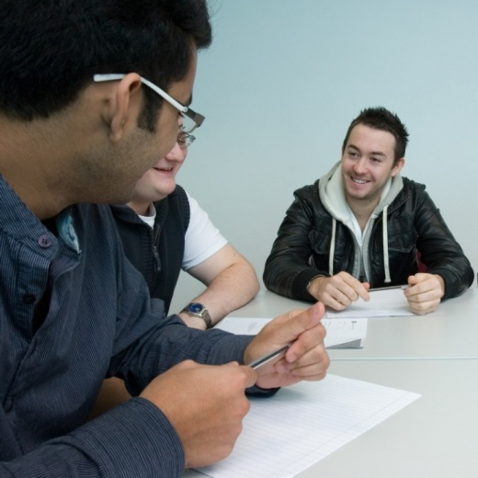
Sport Department project
Quantitative and qualitative data collected over 3 academic years
Online questionnaire survey to all international sports students
International student focus groups - countries of origin
Academic staff focus groups
Student Support Officer focus groups

Slide 9
CRM/induction experiences
Difficulties and challenges - students and staff
LTA and academic support
Student Support services
Staff cultural awareness
Staff accessibility and approachability
Other University services
Areas for improvement

Slide 10
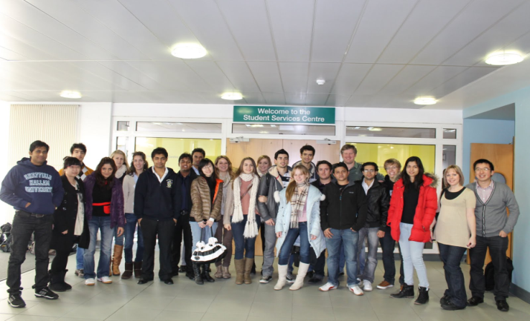
Mixed experiences
Significant differences between cultural groups and between courses
EU and North America students tend to have more positive experiences
Chinese and other Asian students often experience the biggest challenges
Need to improve the quality and consistency of teaching and academic support for international students
Careers and employability provision also needs to improve
'Cultural separation'

Slide 11
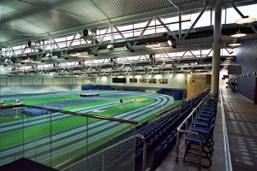
Work in progress
CRM and extended induction (continuous improvement)
University services project
Time allocations - academic staff
Social activities
Cultural awareness initiatives
Student interactions research
Employability research
CDA

Slide 12

Student interactions research
Student interactions in the formal learning environment
1. Cultural assumptions and/or preconceptions - do they exist?
2. Varying integration between home and international students
3. The need to develop of intercultural skills for staff and students

Slide 13

MSc Sport Business Management course
Ethnographic approach over 2 semesters
Diverse student cohort
- classroom observations
- listening
- field notes
- informal follow up interviews (clarification)

Slide 14
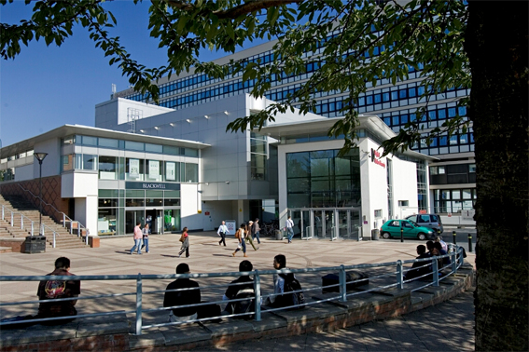
Results
The need for professional practice improvements
Chinese students sitting together away from other students
Chinese students remaining quiet and passive in sessions
Cultural and linguistic sensitivity
differences
Non diverse lecture materials

Slide 15

Acting on the findings
Outcomes reviewed and monitored
Briefing sessions - sharing the findings
Advice, guidance and support - verbal and written
Course team action plan

Slide 16

Opportunities and challenges
The development of teaching assistant roles
Student and staff exchange (Erasmus)
Professional development
CDA
Professionally
  Winning hearts and minds
  Securing the right balance
  Resources
  Strategic leadership and support

Slide 17


Hazel h.e.horobin@shu.ac.uk
Miyoung m.oh@shu.ac.uk
Chris c.cutforth@shu.ac.uk

Slide 18

Thank you
Questions?

